Slide 1



RGW Snapshots
Yehuda Sadeh Weinraub
04/02/2019
Notes:
This is the customer facing presentation for IBM Spectrum Scale and includes discussion about IBM Elastic Storage System (ESS).
IBM Spectrum Scale is an industry-leading software-defined data and storage management solution for AI, big data, analytics, and high-performance computing (HPC) workloads with its industry-leading performance and scalability, and a wealth of sophisticated data platform capabilities.
For the seller enablement presentation and other Scale and ESS assets, please visit the Seismic Sales Kit page: https://ibm.seismic.com/Link/Content/DCSIK9L_wLz0695lBHvwCvQw
For questions or comments on this presentation, please feel free to contact David Wohlford (David.Wohlford@ibm.com).
1

Slide 2
Ceph RGW Snapshots: Motivation
Backup
Currently possible via bucket activity logs
Cannot provide a point in time consistent state
Potential races when consuming logs, e.g., log entry is written before object is created, backup software cannot know if it was already written and removed or was not written yet, so potential to miss objects
Backup software needs to rely on timing of log generation rather than on its own schedule
Object Versioning
Keeps history at the object level, so might not be not easy to recover a consistent application state
Useful for archiving all history, harder to manage on a per-need basis
…

Slide 3
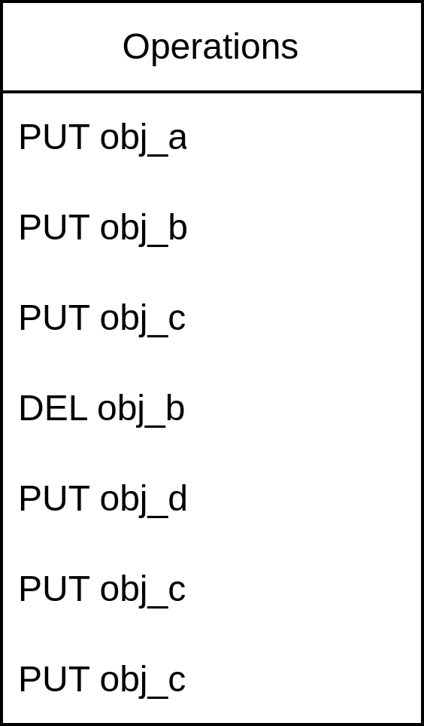
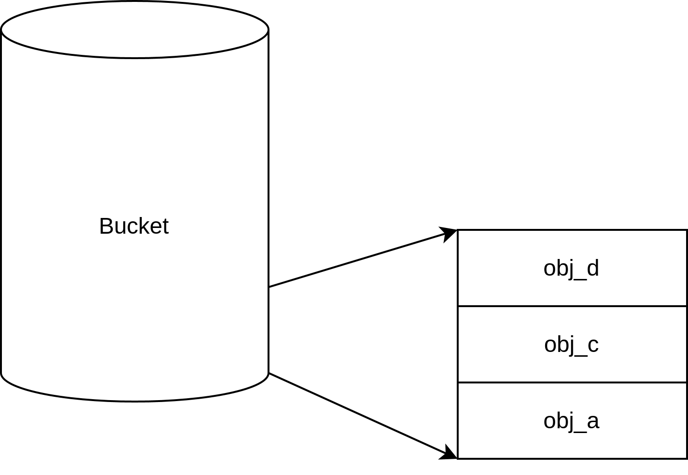
S3 Object Model (Non-Versioned)
When versioning feature disabled (as in was never enabled) only single version for each object exists. Does not keep history or knowledge of deleted objects
Versioning Disabled Example

Slide 4
S3 Object Model (Non-Versioned)
As backup is not atomic, there is no way to guarantee which of the different object versions are going to be backed up.
In this example, object obj_b may or may not exist, and obj_c might have 3 different versions
Backup Start
Backup End
Versioning Disabled Backup Example

Slide 5
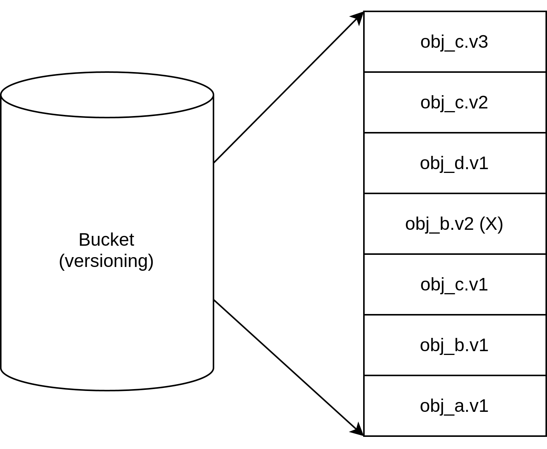
S3 Object Model (Versioned)
When versioning feature enabled all object versions are preserved (unless explicitly removed). Object removal without explicitly remove a specific version will create a delete marker and keep the old versions
Versioning can be suspended (but not disabled!) -- in which case all versions will get the same ID. Delete markers will still be created on non-explicit object removal.
Versioning keeps all history of all objects, requires application housekeeping, otherwise can lead to data explosion
No easy way to store a consistent application state
Versioning Enabled Example

Slide 6
S3 Object Model (Versioned)
Better backup consistency
If backup is done on bucket listing, it cannot be guaranteed which changes will be captured.
Backup based on specific object version IDs will be able to capture these – logs will need to include specific version IDs that are generated by the system, not every access log provides these
Backup Start
Backup End
Versioning Enabled Backup Example

Slide 7
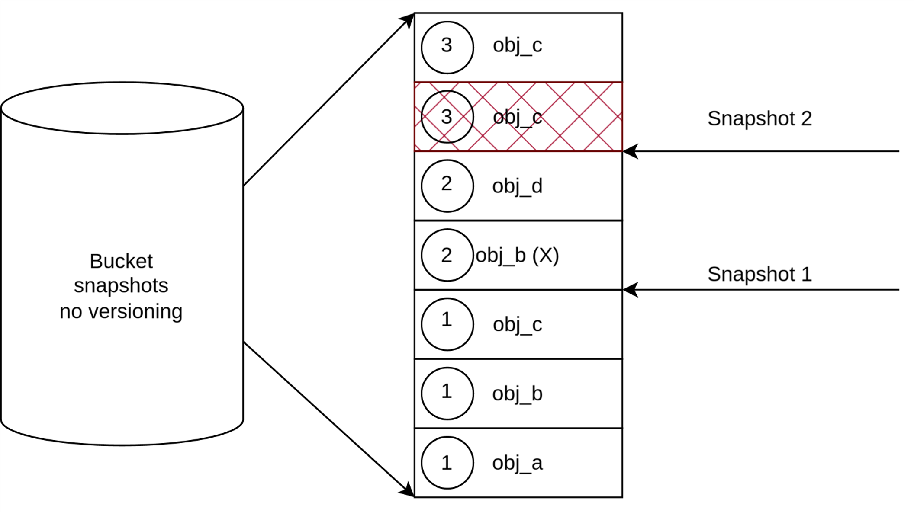
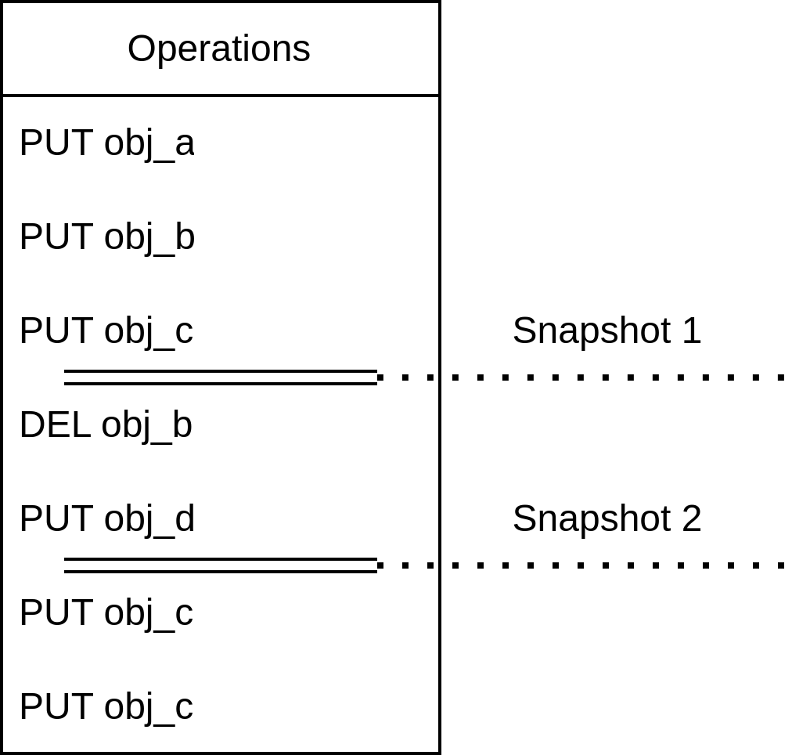
Bucket Snapshots (Non-Versioned) Proposal
Snapshots on buckets when versioning is disabled will only keep a single new object instance for every snapshot
Can list objects that existed when a snapshot was taken
Can list objects that were created between snapshots creation (e.g., all new objects in the snapshot)
Delete markers for object removal
Does not require tracking operation logs for backup
Application level consistency
Non-Versioned Bucket Snapshots

Slide 8
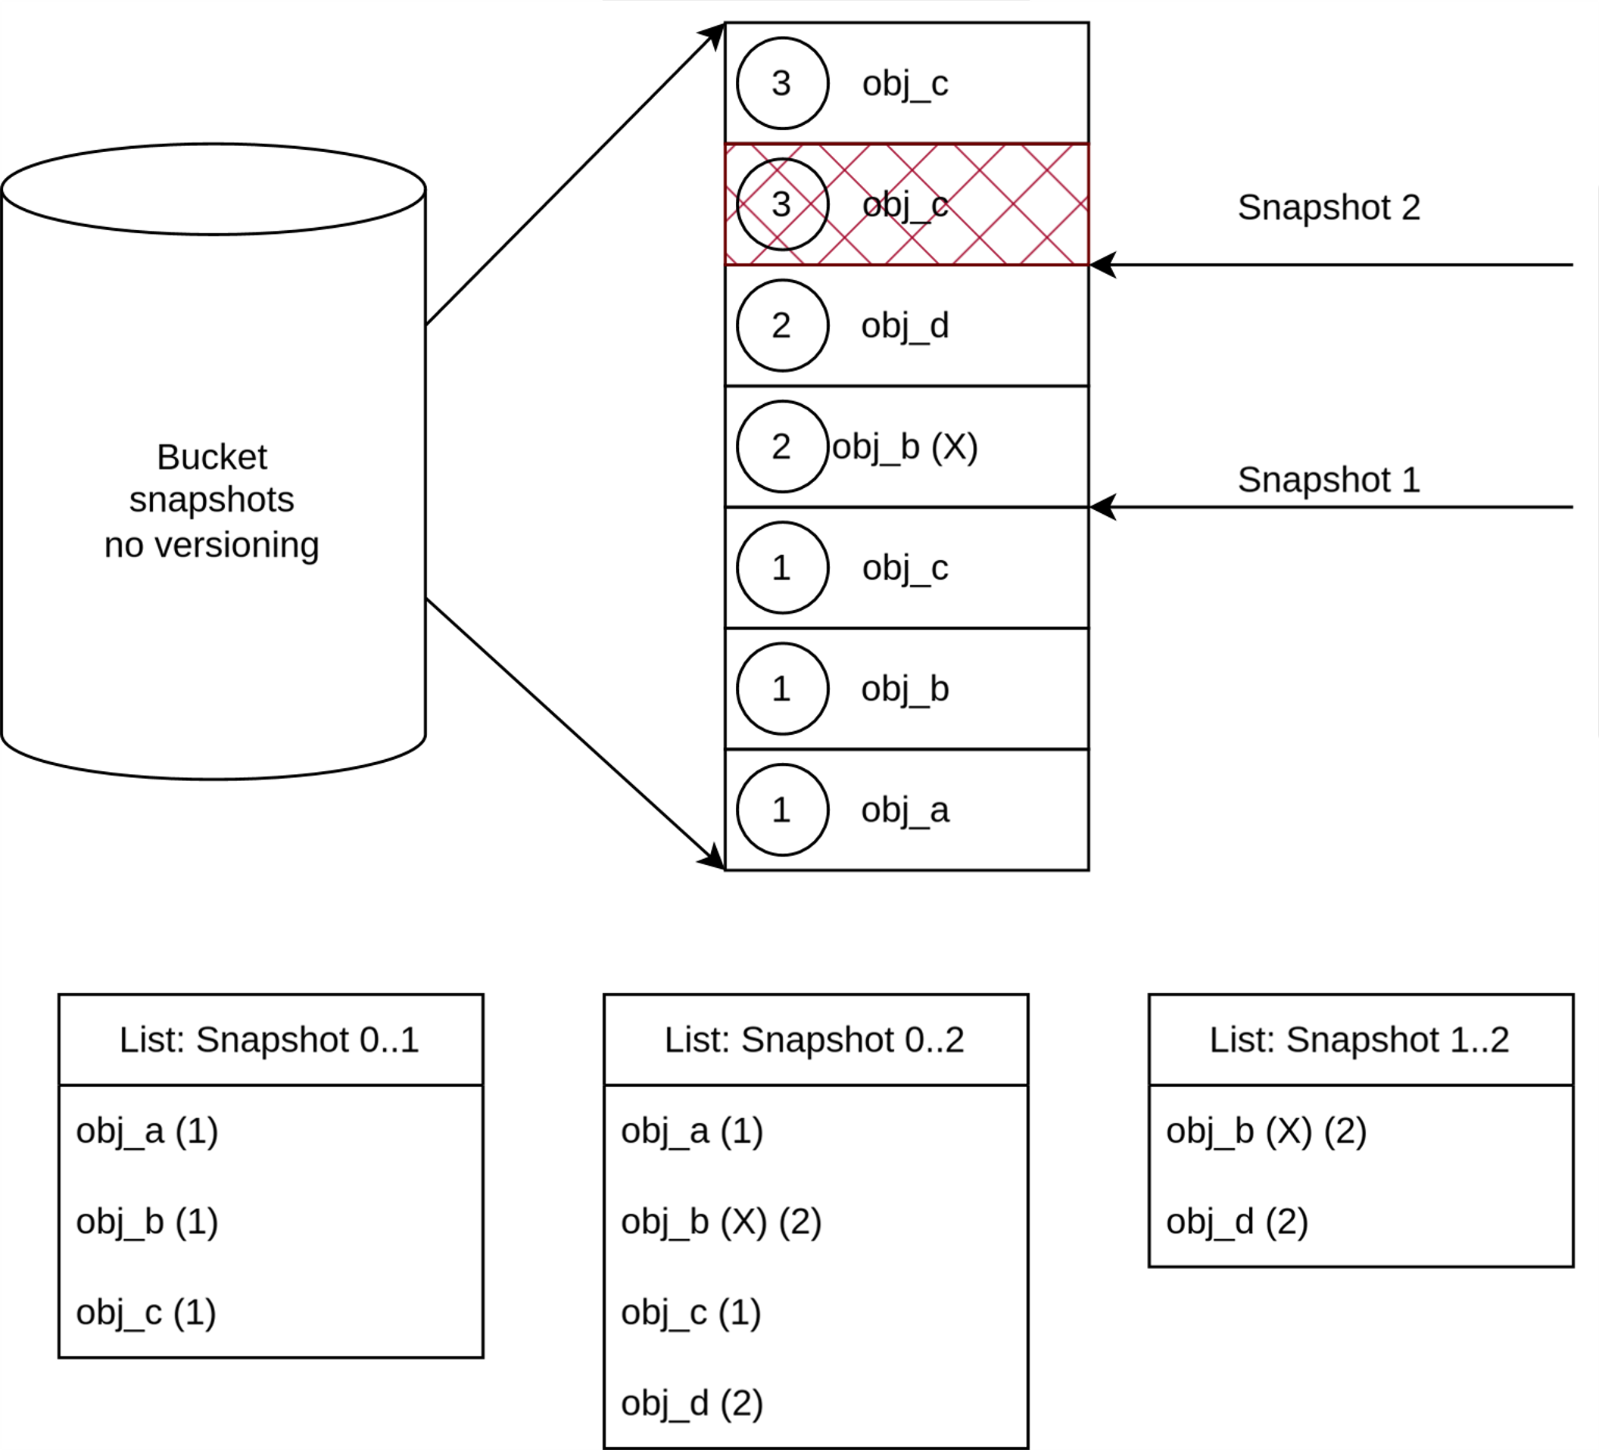
Bucket Snapshots (Non-Versioned) Proposal
Bucket listing by a range of snapshots will return all the object changes that happened in that range
Non-Versioned Bucket Snapshots

Slide 9
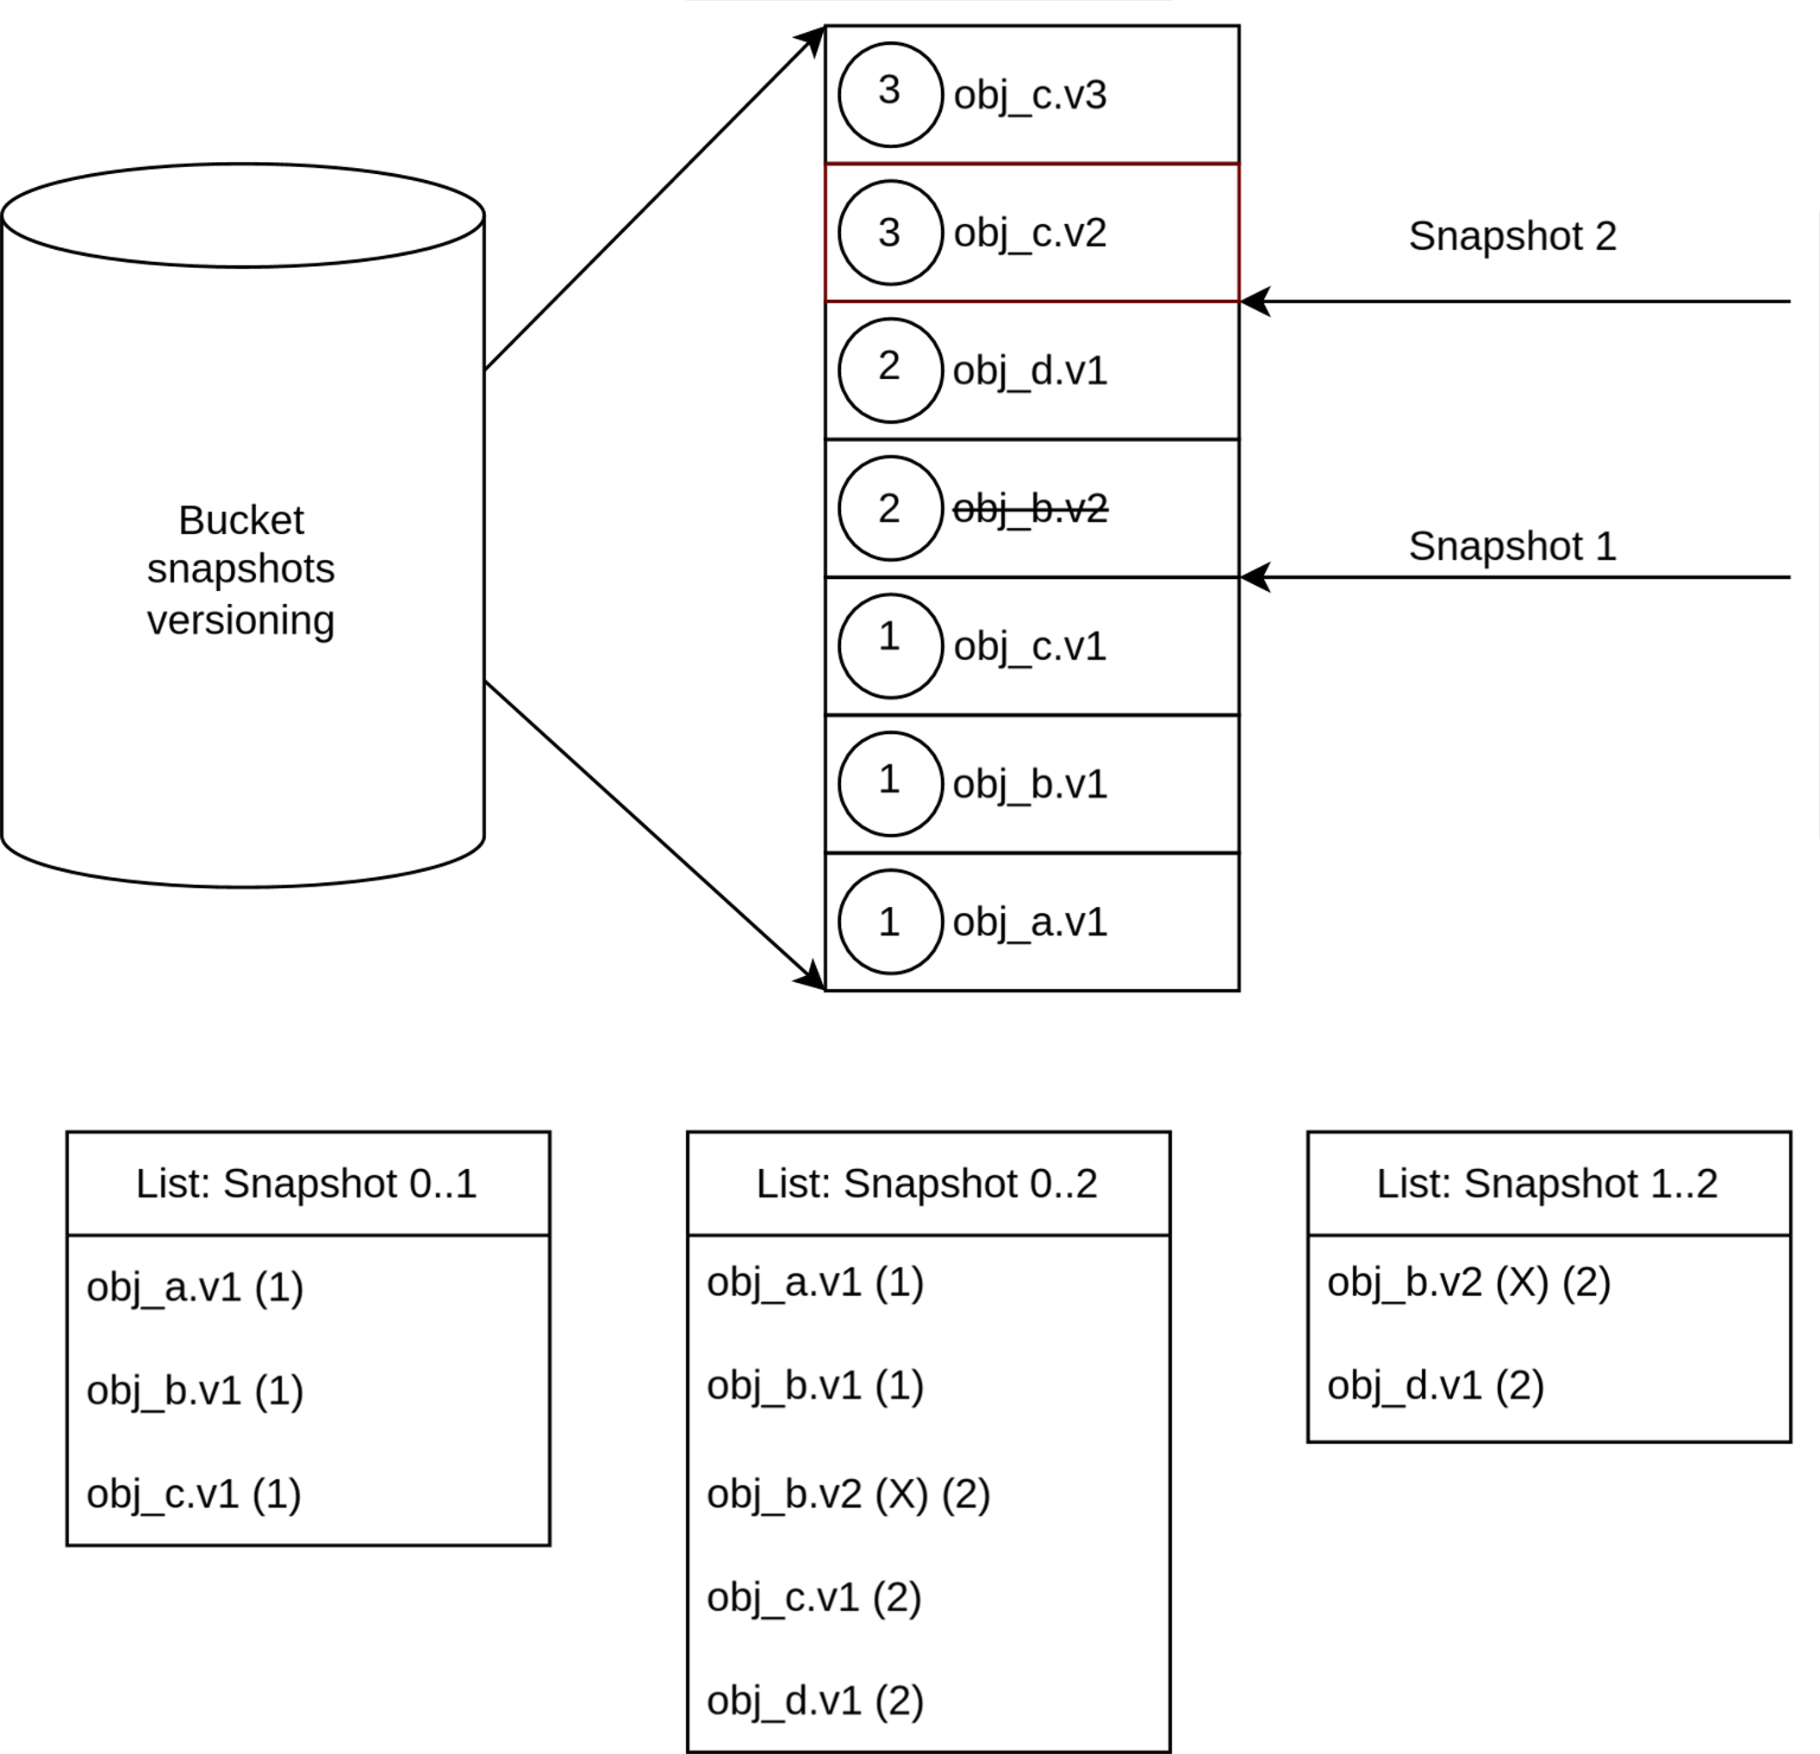
Bucket Snapshots (Versioned) Proposal
Bucket listing by a range of snapshots will return all the object changes that happened in that range
Listing can request either all the versions, or only the most recent versions for each object (as with regular versioned objects)
Versioned Bucket Snapshots

Slide 10
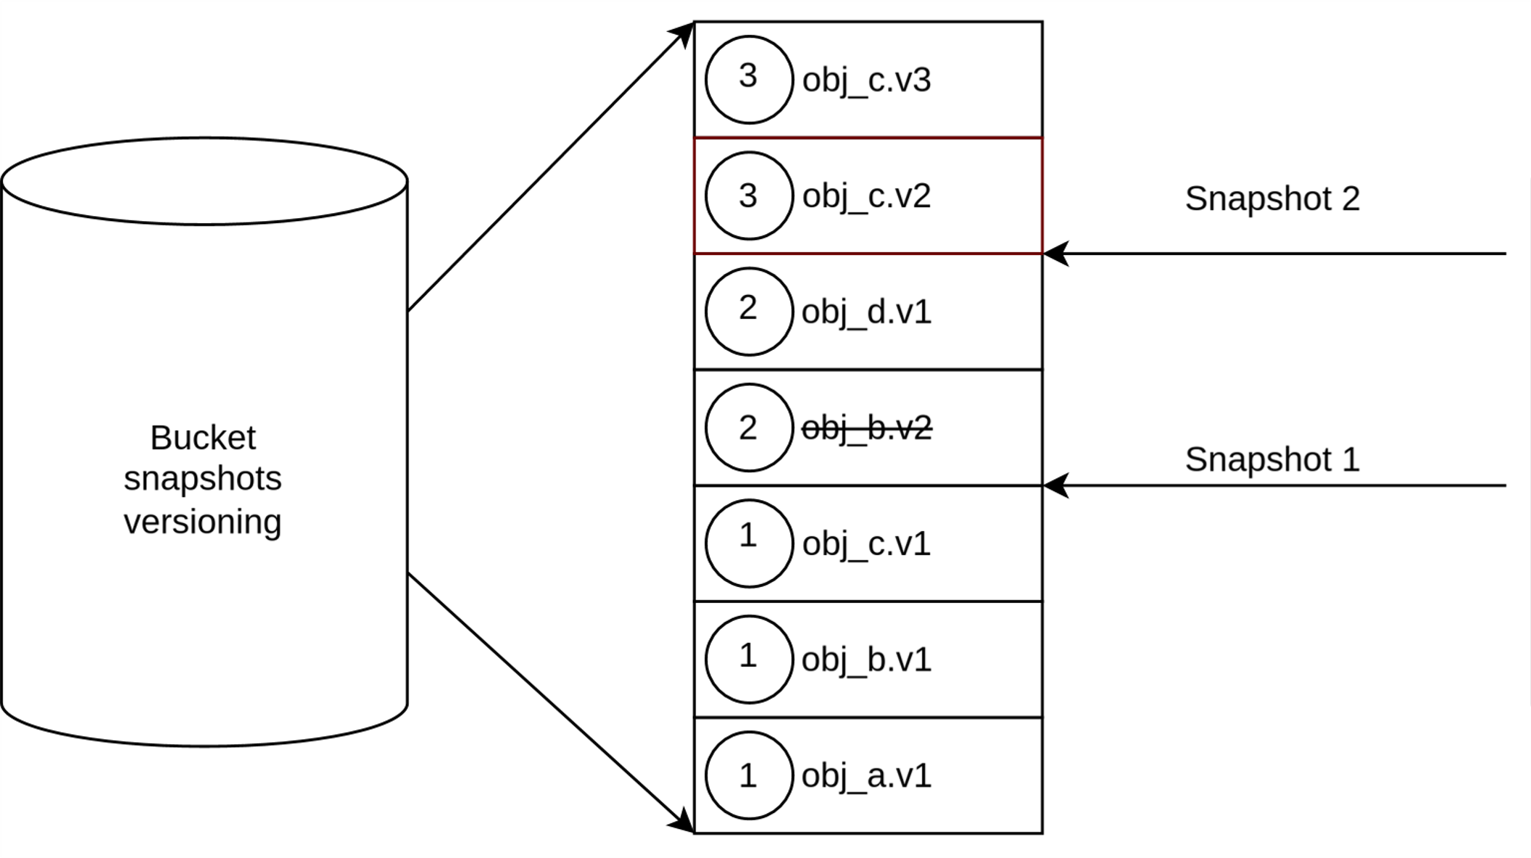
Bucket Snapshots (Versioned) Proposal
Snapshots on buckets when versioning is enabled will keep all instances as with regular versioning
Can list object versions that existed when a snapshot was taken
Can list object versions that were created between snapshots creation (e.g., all new objects in the snapshot)
Delete markers for object removal (regular behavior)
Does not require tracking operation logs for backup
Application level consistency
Versioned Bucket Snapshots

Slide 11
Bucket Snapshots (cont.)
Can access objects using a specific snapshot ID. Unlike object versions, snapshot IDs have can have a semantic meaning (whereas object versions are generated randomly).
Bucket Inventory: inventory of objects that exist or that were modified prior to when the snapshot was taken
Can leverage lifecycle to retire snapshots or move them into different storage class or secondary storage
Revert objects (and possibly bucket) state to a specific snapshot
Objects instances that are part of a snapshot are read-only and unremovable

Slide 12
Bucket Snapshots: Backup
A bucket backup solution that is based on snapshots can take a snapshot prior to backing up the data, and leverage bucket snapshot listing to identify the object instances that need to be backed up.
Alternatively it can use bucket inventory API that is snapshots aware to get the relevant object instances

